Slide 1

AC Power Analysis
Effective or RMS Value
Section 11.4
Md. Shafqat Talukder Rakin
Lecturer, Department of CSE,
United International University
Email id : shafqat@cse.uiu.ac.bd

Slide 2
Effective or RMS Value

Slide 3


Slide 4
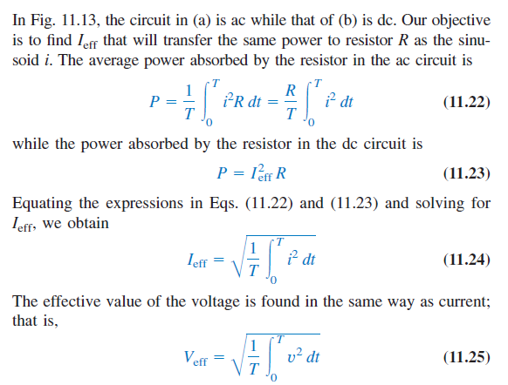
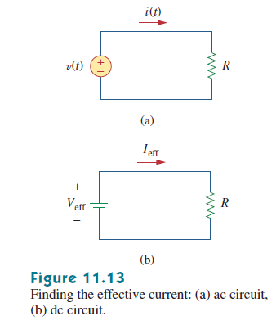
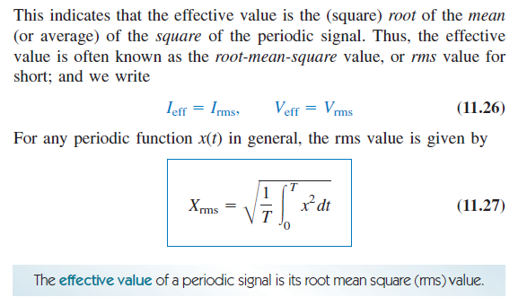
calculation

Slide 5
Steps to find the rms value
Step-1:
Find its square
Step-2:
Find the mean
Step-3:
Find the square root of that mean

Slide 6

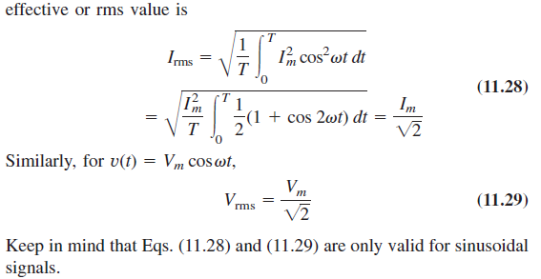
Calculation of i(rms) and v(rms)

Slide 7
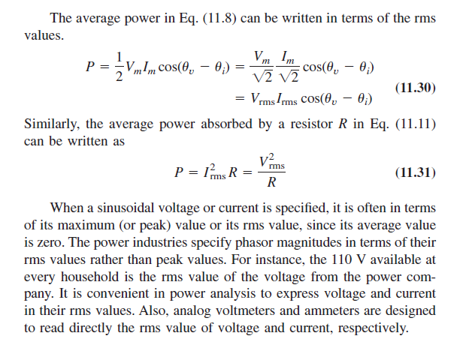
Avg power in terms of rms

Slide 8
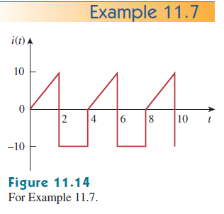

Math Problem Practice:
Reference: Sadiku_Example_11.7

Slide 9
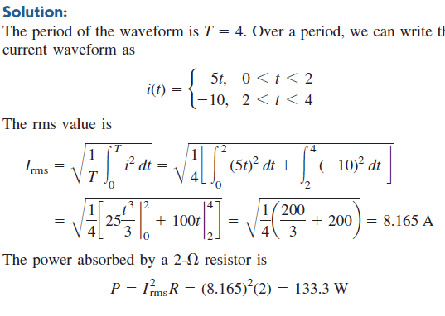
Math Problem Practice:
Reference: Sadiku_Example_11.7

Slide 10
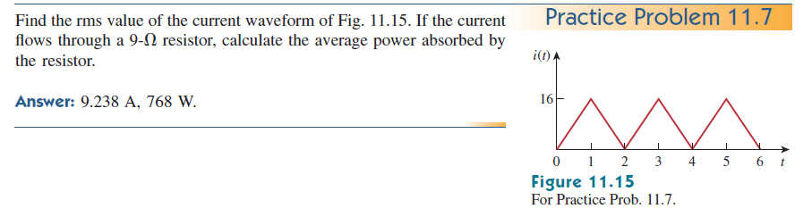
Math Problem Practice:
Reference: Sadiku_Practice_Problem_11.7

Slide 11
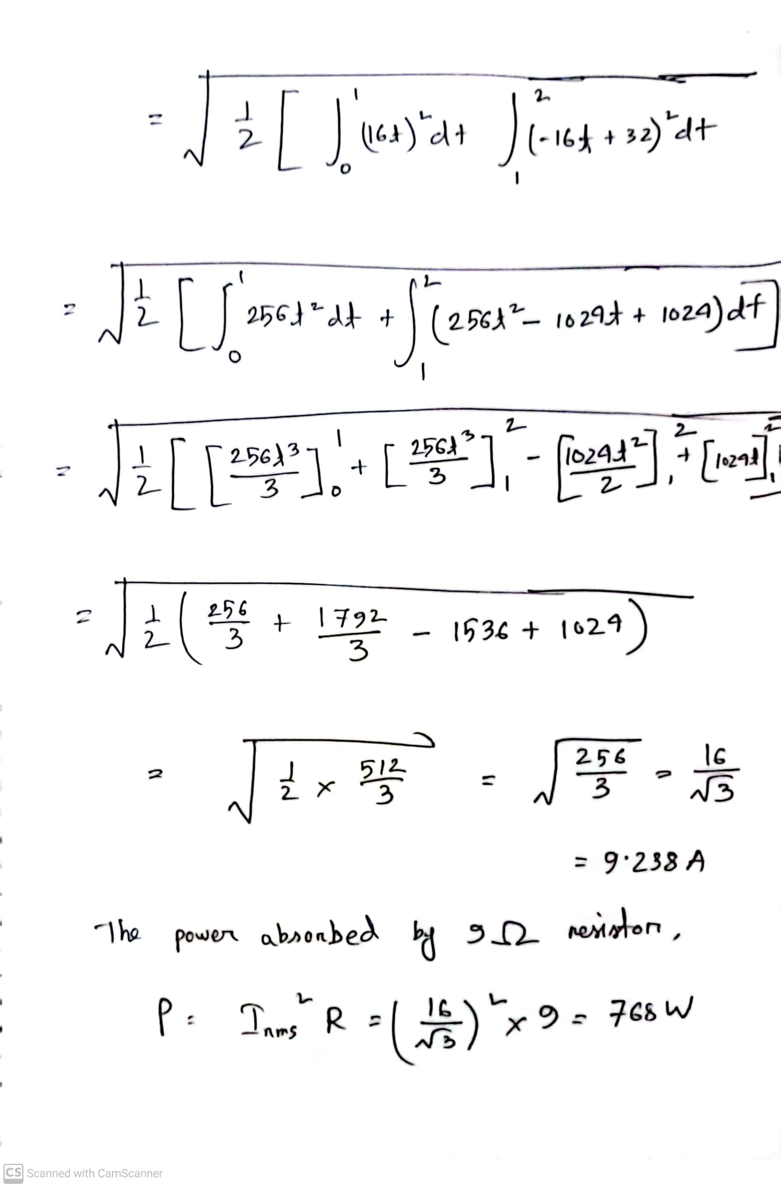
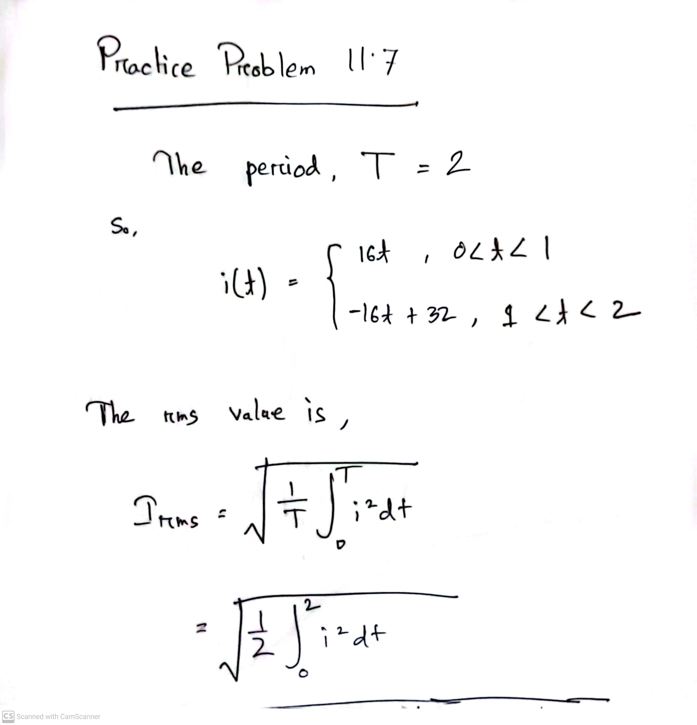
Math Problem Practice:
Reference: Sadiku_Practice_Problem_11.7

Slide 12
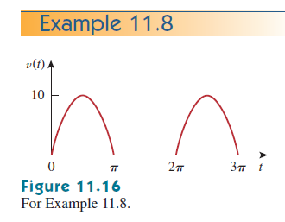

Math Problem Practice:
Reference: Sadiku_Example_11.8

Slide 13
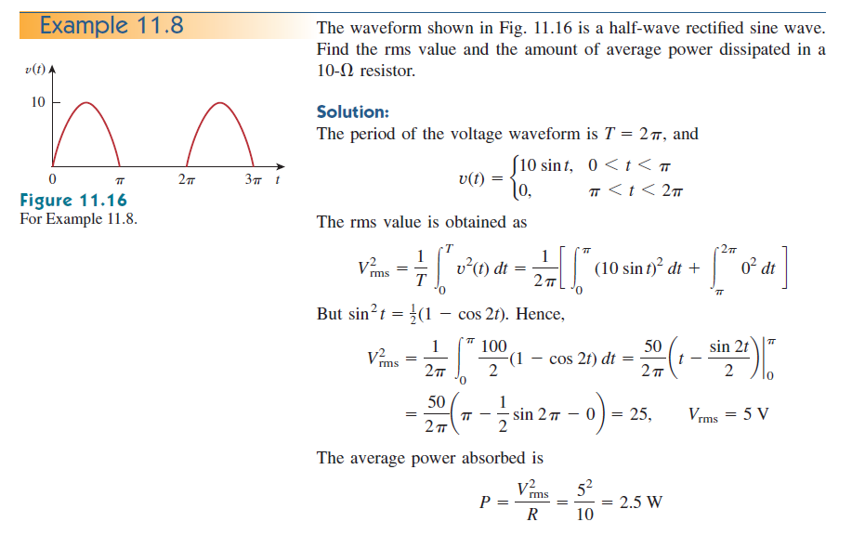
Math Problem Practice:
Reference: Sadiku_Example_11.8

Slide 14
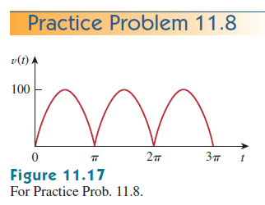
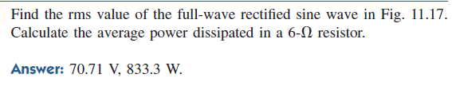
Math Problem Practice:
Reference: Sadiku_Practice_Problem_11.8

Slide 15
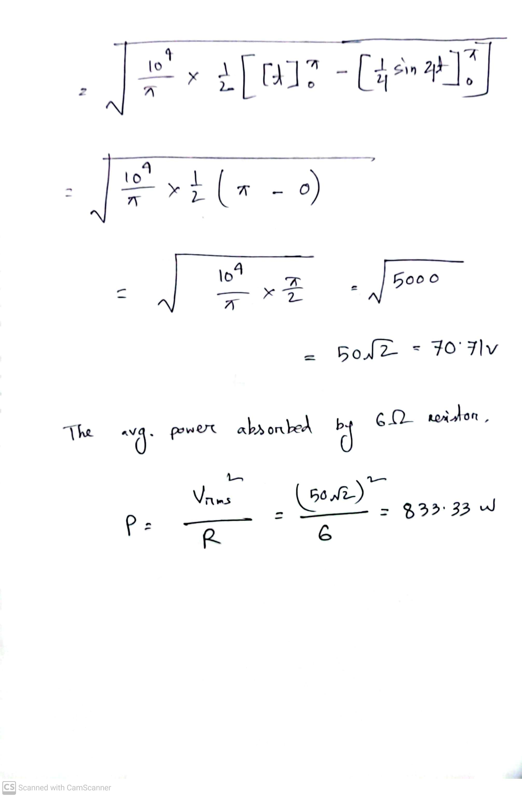
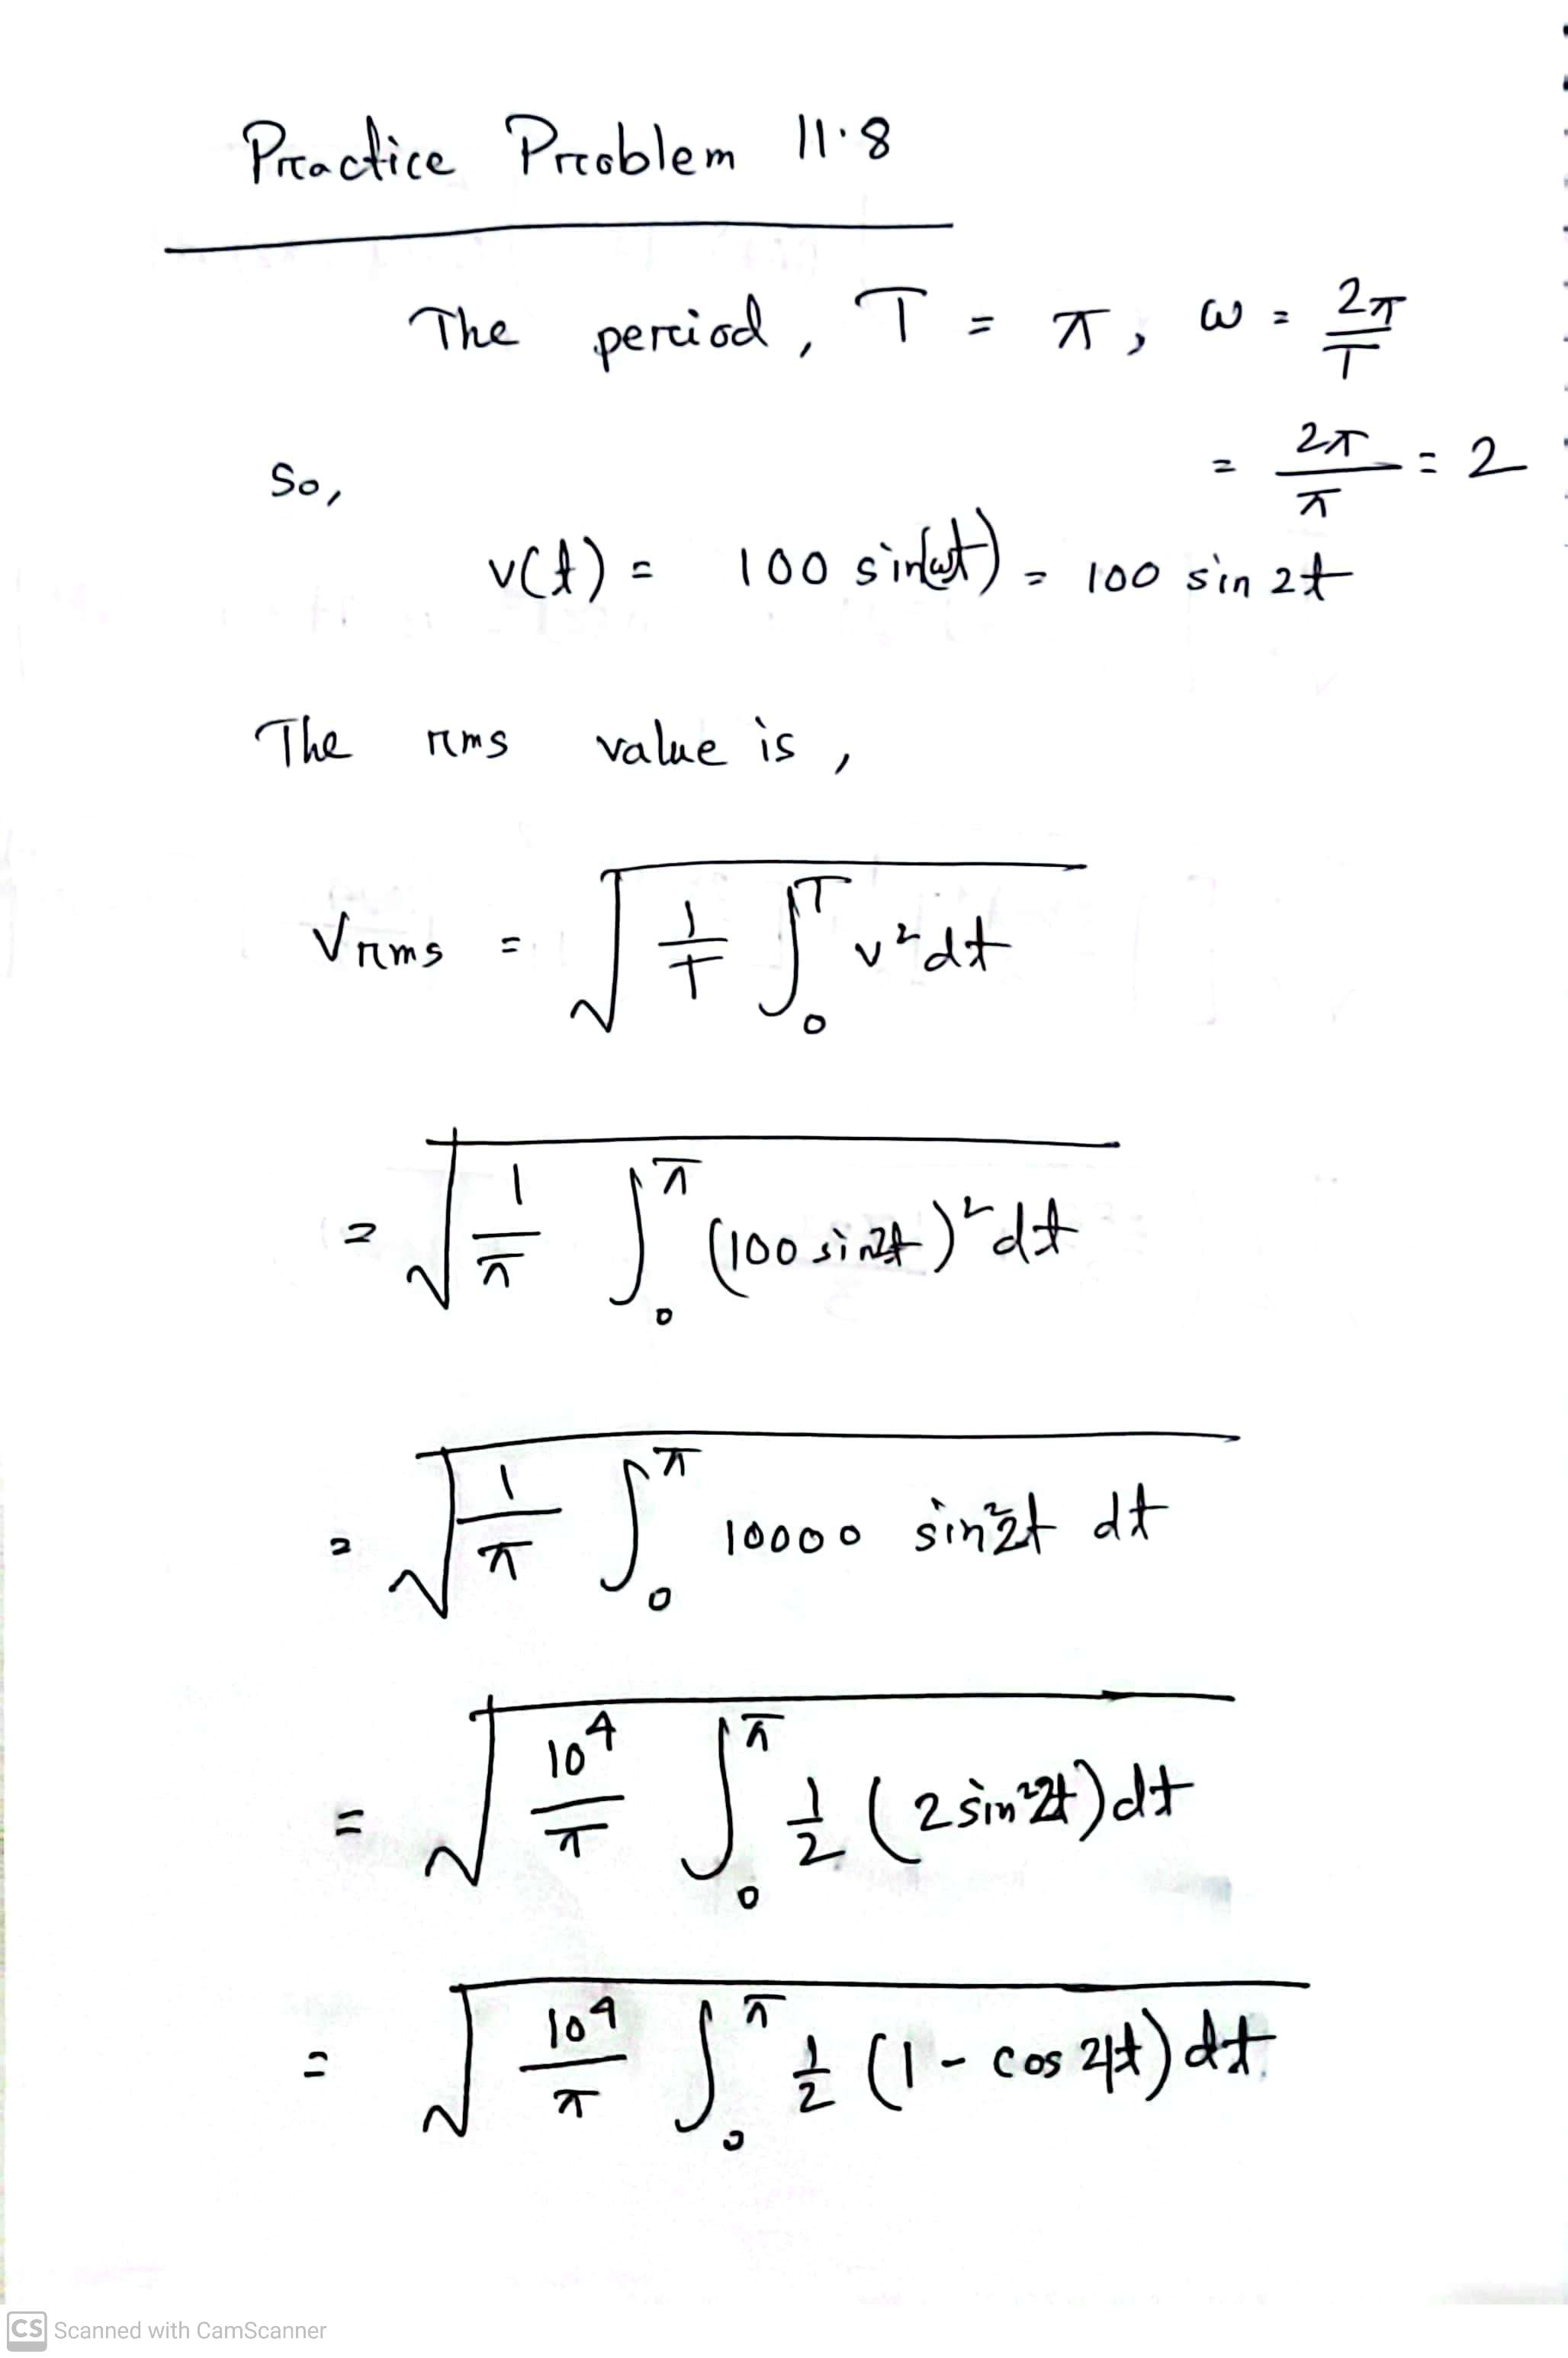
Math Problem Practice:
Reference: Sadiku_Practice_Problem_11.8

Slide 16
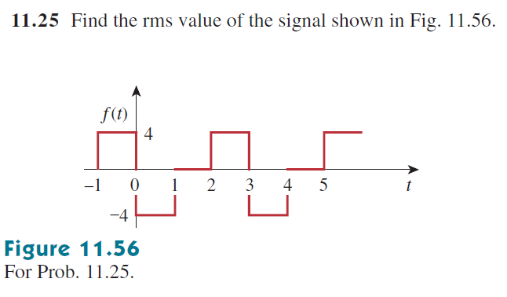
Math Problem Practice:
Reference: Sadiku_Exercise_11.25

Slide 17
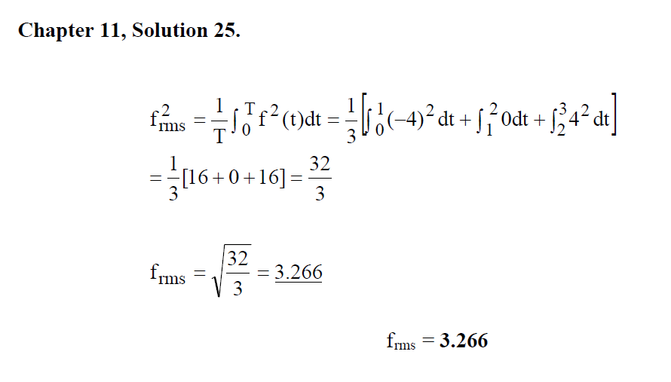
Math Problem Practice:
Reference: Sadiku_Exercise_11.25

Slide 18
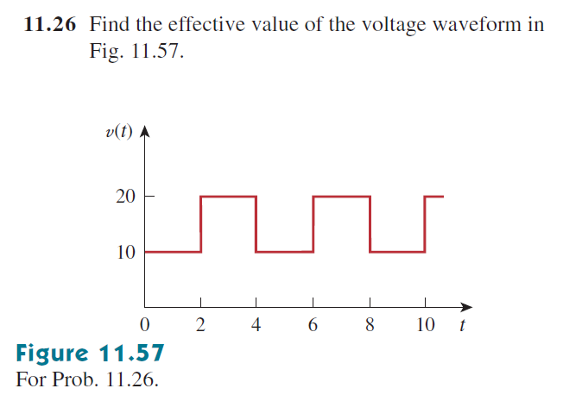
Math Problem Practice:
Reference: Sadiku_Exercise_11.26

Slide 19
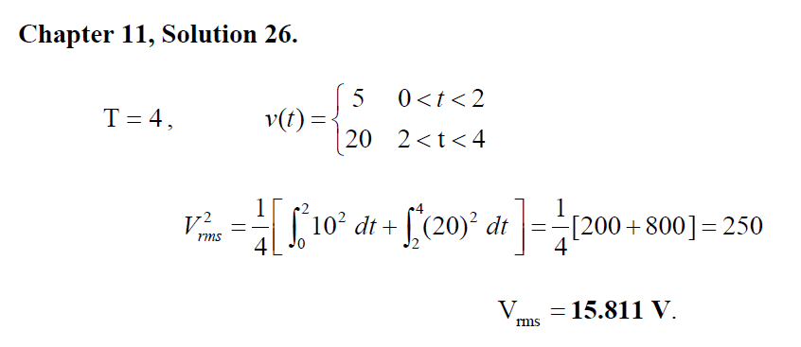
Math Problem Practice:
Reference: Sadiku_Exercise_11.26

Slide 20
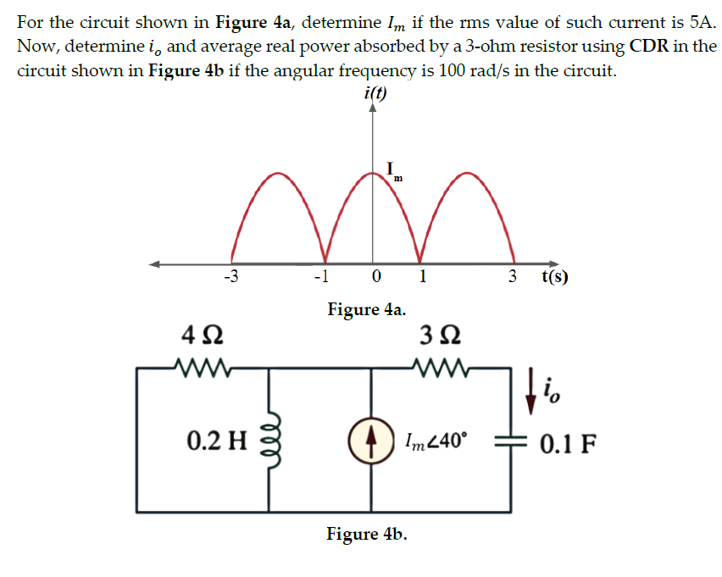
Fall 2023

Slide 21
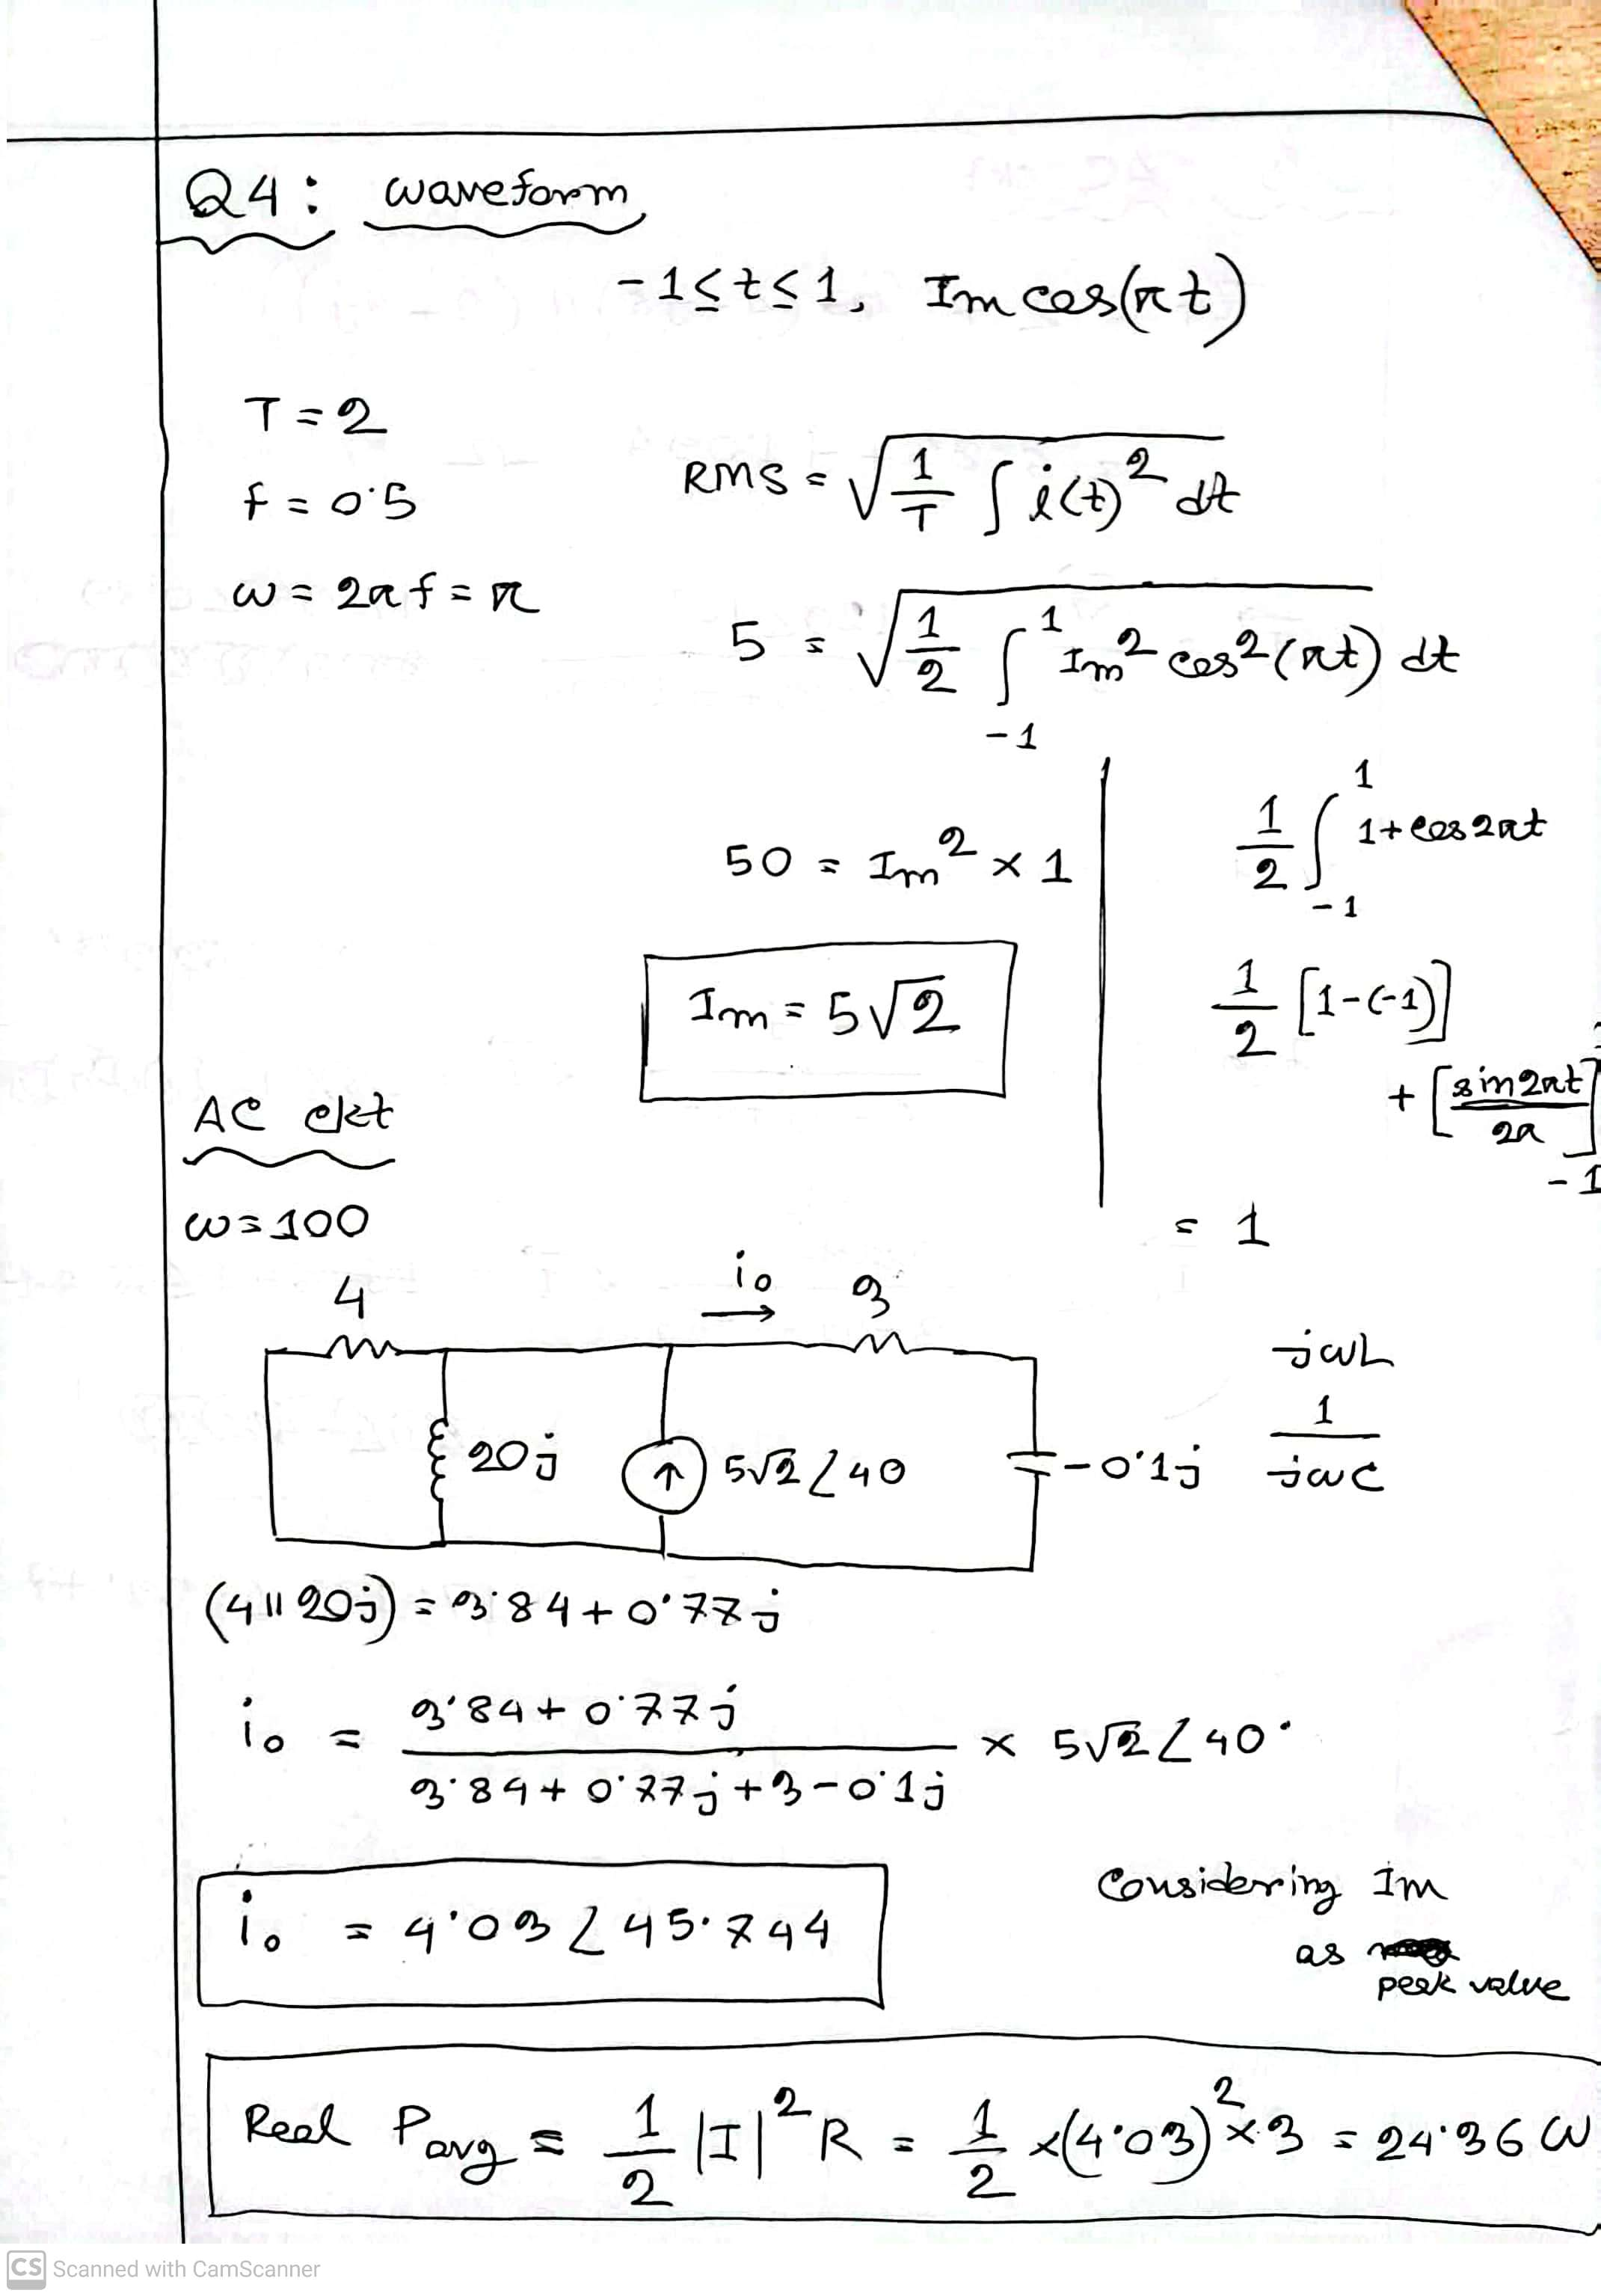
Fall 2023

Slide 22
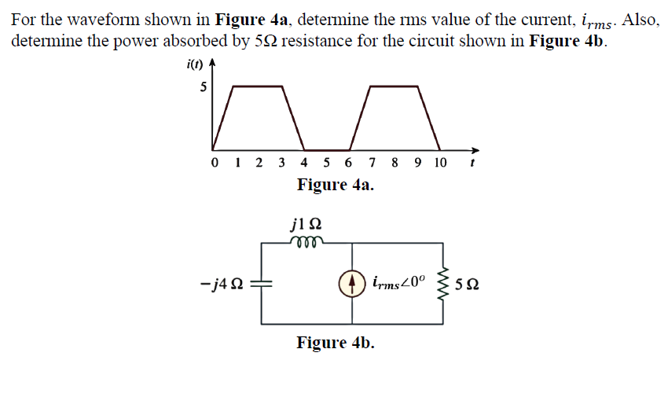
Summer 2023

Slide 23
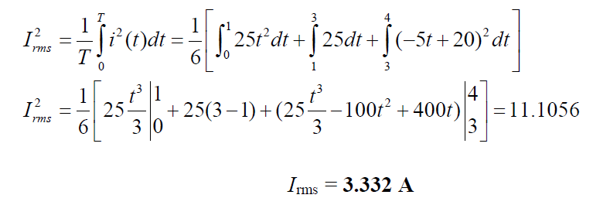
Summer 2023

Slide 24
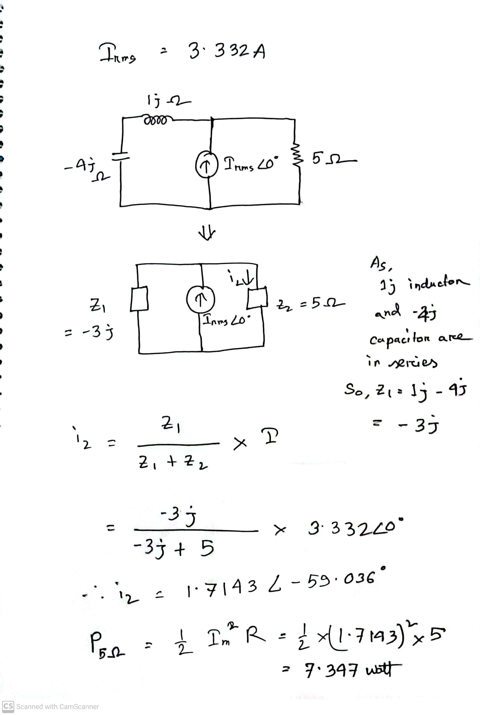
Summer 2023

Slide 25
References for better understanding
Links to go through in Power Calculation:
RMS and average value concept:
What is RMS value? (& why should we care?) | Alternating currents | Physics | Khan Academy (youtube.com)
RMS value and power calculation math:
RMS (Effective) Value || Average Power || Example 11.7, 11.8 & Practice 11.7, 11.8 || (Bangla) (youtube.com)
RMS Value (Solved Problem) (youtube.com)
Complex Power (No more Confusion) || Example 11.11 || Practice Problem 11.11 || ENA 11.6 (B) (youtube.com)

Slide 26
References for calculator use for complex numbers
Complex Number calculations in calculator:
Complex Number Operations in Calculator (Bangla Tutorial) #ComplexNumberOperationsBanglaTutorial (youtube.com)
FX 991ES + Scientific Calculator Conversion of Rectangular to Polar & Polar to Rectangular (youtube.com)
Rectangular to Polar form in fx-991MS calculator (youtube.com)
Casio FX-991EX Classwiz Complex Numbers: Rectangular to Polar Form Conversions (and Vice Versa) (youtube.com)

Slide 27
Math to Practice from the Book for Exam
Chapter 11
Example:
11.8
Practice Problem:
11.8
Problem:
11.25, 11.26

Slide 28
Thank you

